Slide 1
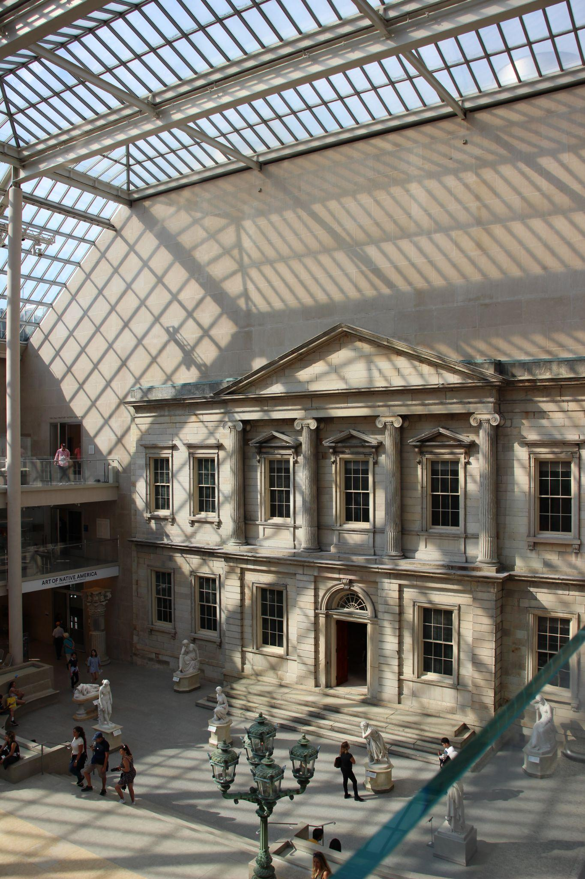
THE MET HIGHLIGHTS
PREDICTING
METROPOLITAN MUSEUM’S
HIGHLIGHTING STRATEGY

Slide 2
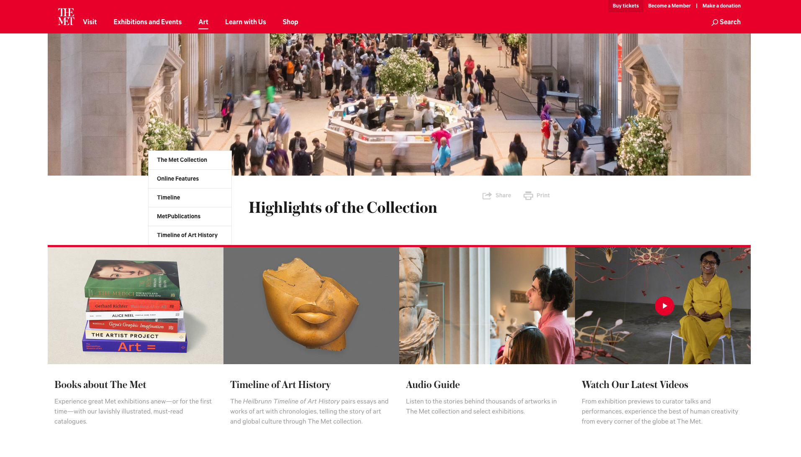

Slide 3
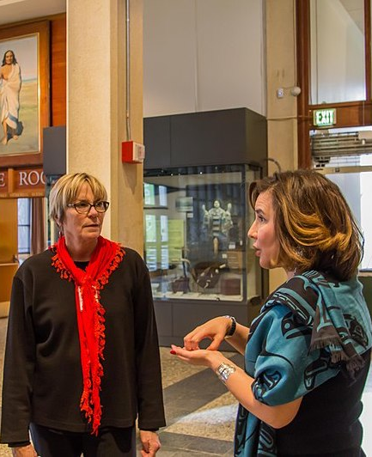
01
Background

Slide 4
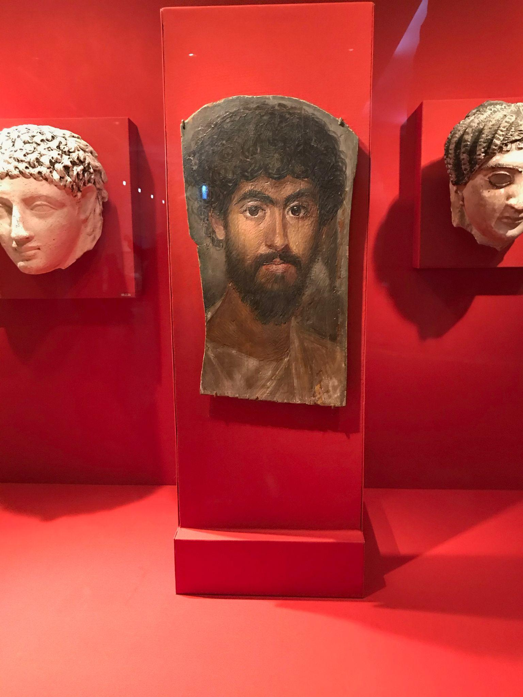
Patronage
GOAL:
Visibility
TRYING TO MEASURE:
Chances of
An object being highlighted
Given that it is donated to the museum

Slide 5
02
Solution

Slide 6
Dataset:
Met Museum Open Access CSV
(448, 203 objects)
Departments:
20
4 different collecting practices

Slide 7
4 Groups:
1.
Egyptian Art
3.
Ancient
(5 departments)
Modern
215, 649 objects
Features include:
Department
Object Name
Artist Role
Artist Nationality
Object Date
Medium
Classification
2.
Categorical
(7 departments)
4.
Modern
(7 departments)

Slide 8
Patronage Barometer
 | Predicted: No highlight | Predicted: Highlight
Actually Not highlighted | You know, Stuff happens | OH NO! 🙀
Actually Highlighted | Love our patrons ♥ | YAY! 🎉

Slide 9
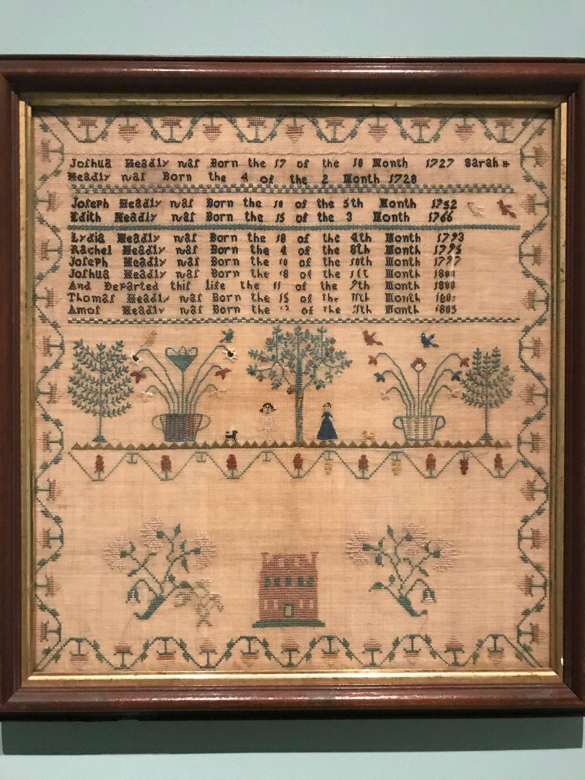
03
Predictive Model

Slide 10
Class Imbalance
750
214,899
HIGHLIGHTED
NOT HIGHLIGHTED

Slide 11
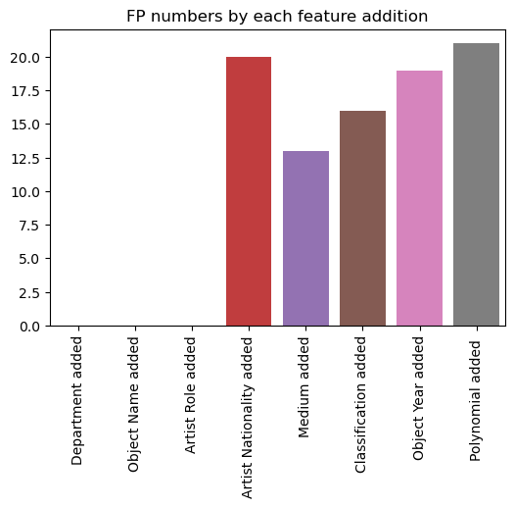
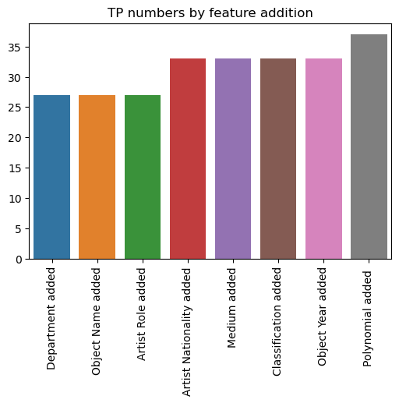
FP numbers by feature addition
TP numbers by feature addition

Slide 12
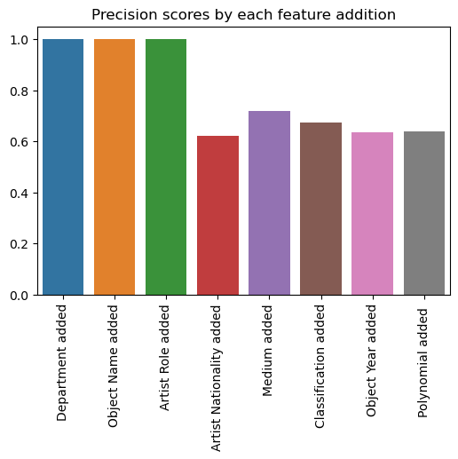
Scores
Precision Score
Train: 0.64
Test: 0.71
F1 Score
Train: 0.37
Test: 0.38
Precision scores by each feature addition

Slide 13
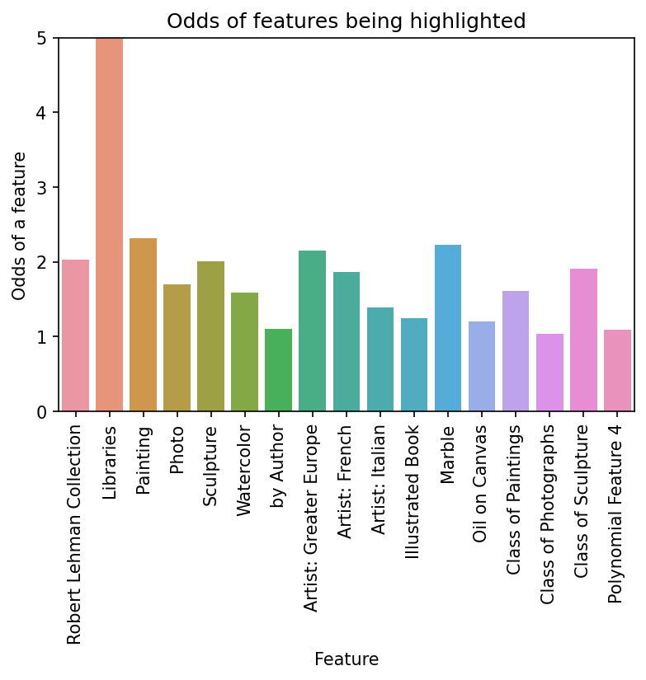
Odds of
Features
Odds of features being highlighted

Slide 14
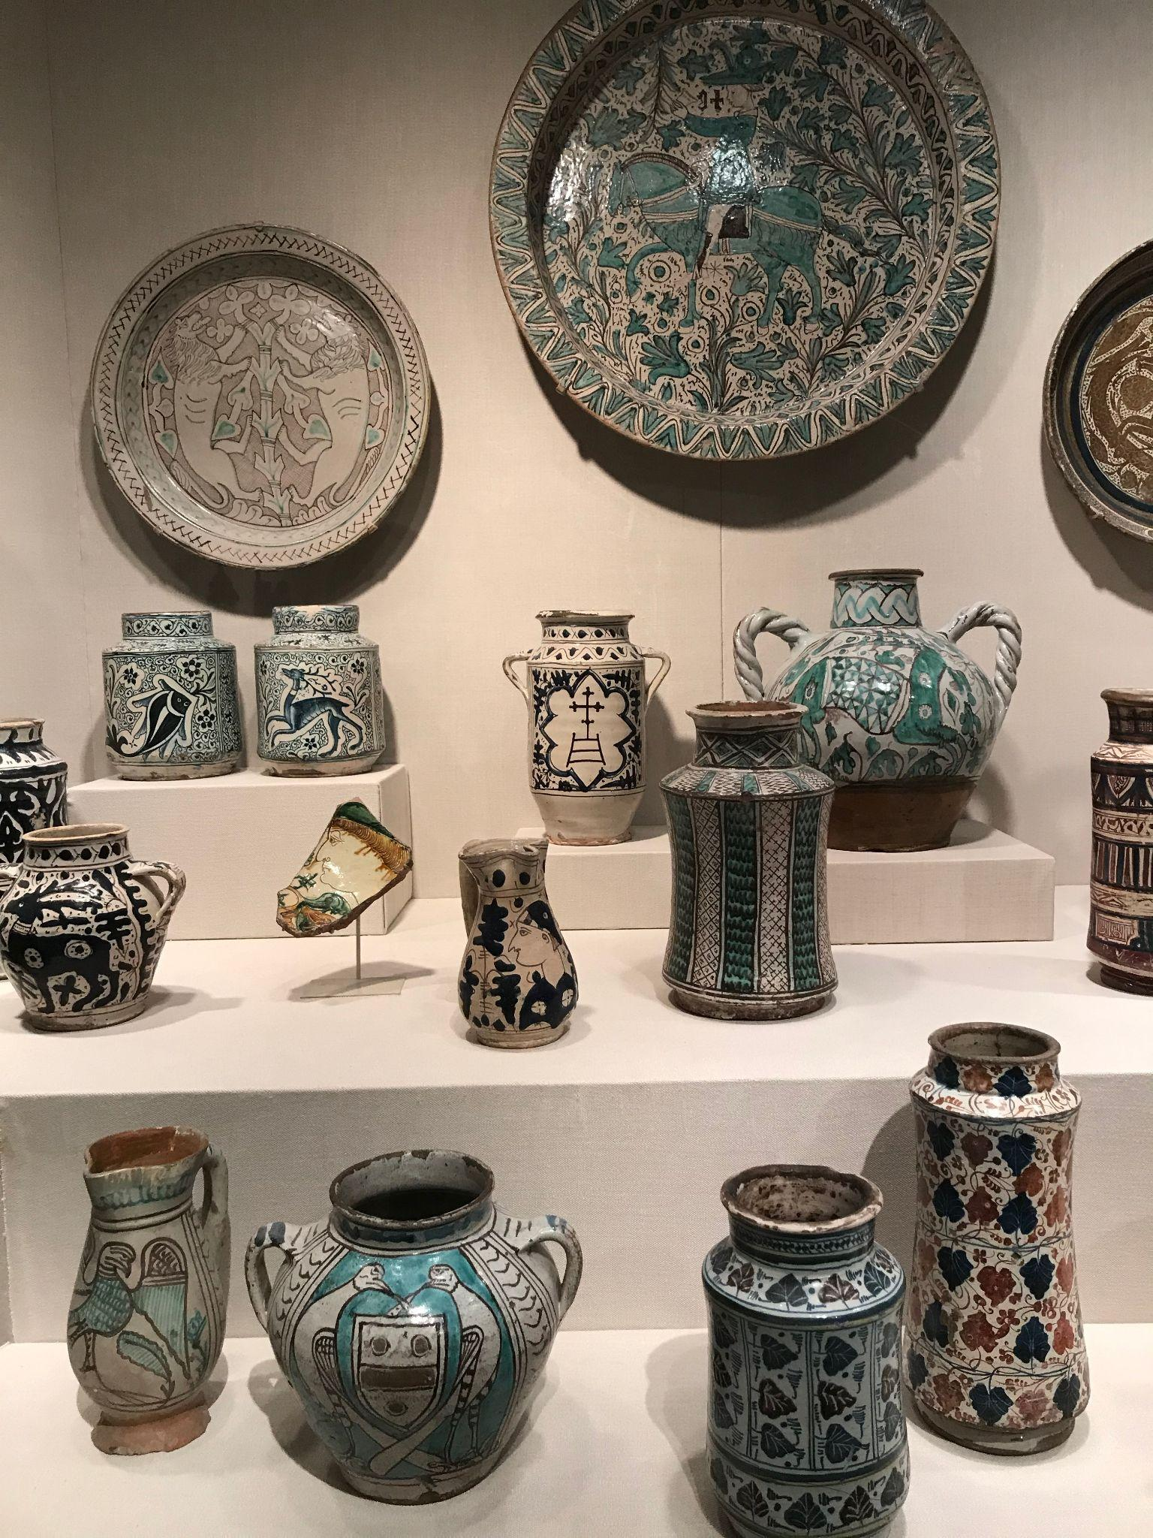
04
Key takeaways

Slide 15
Give your whole collection
Europe, after all (& French)
Marble stands test of time
Robert Lehman Collection
British/German/Dutch/Netherlandish/Spanish
Medium-wise,
marble most likely to be highlighted
Usual suspects: Painting
Odd ones
Libraries
Painting is never dead
Sculpture (expected), Watercolor (not so much)
Big on archives

Slide 16
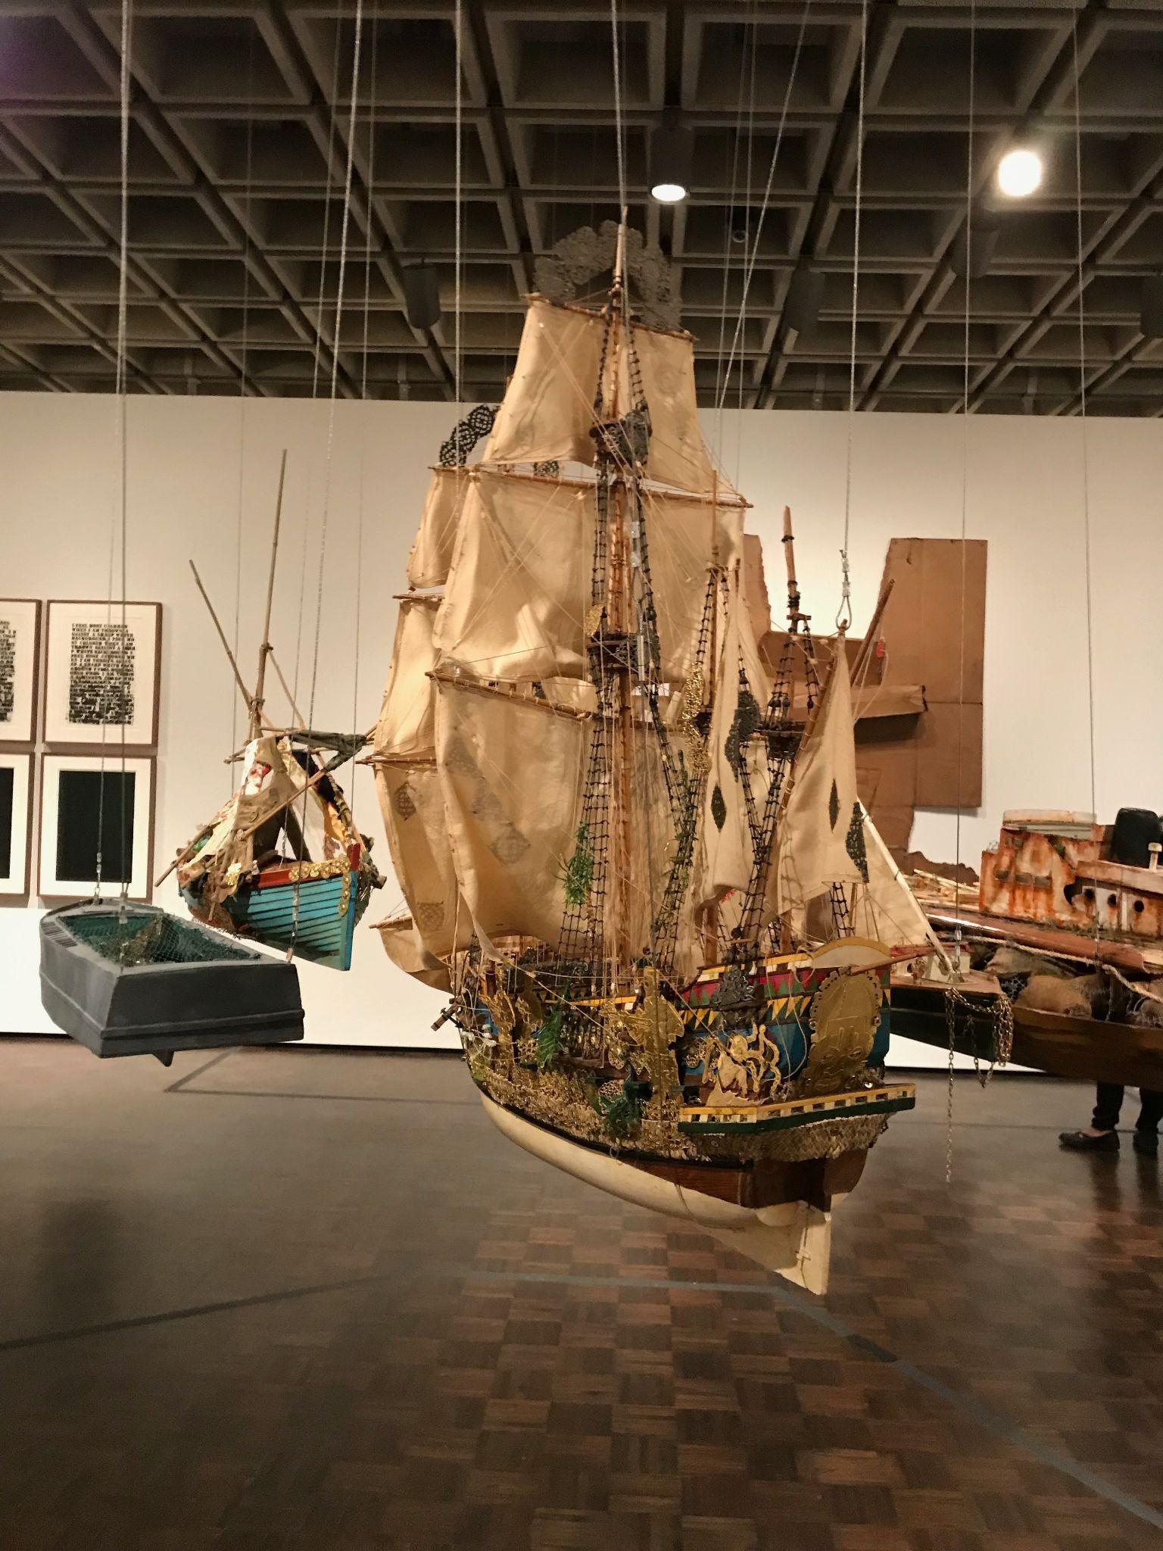
05
Future work

Slide 17
Groups
Models
Mission
Build models for:
Group 1, 2, 3
Try less interpretable, more complex models
Work w/ curators
to align selections w/
director’s mission

Slide 18
Questions?
Photo Credits:
(Museum Highlights) - Photo by @heyminhy on Unsplash
& Appendix

Slide 19
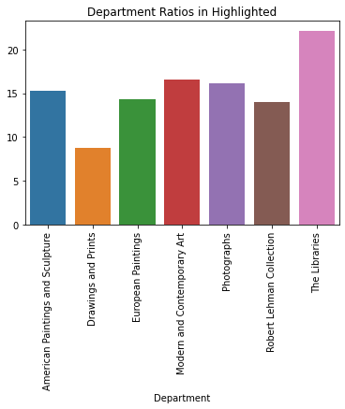
Probability of
Being Highlighted
Department Ratios in Highlighted

Slide 20
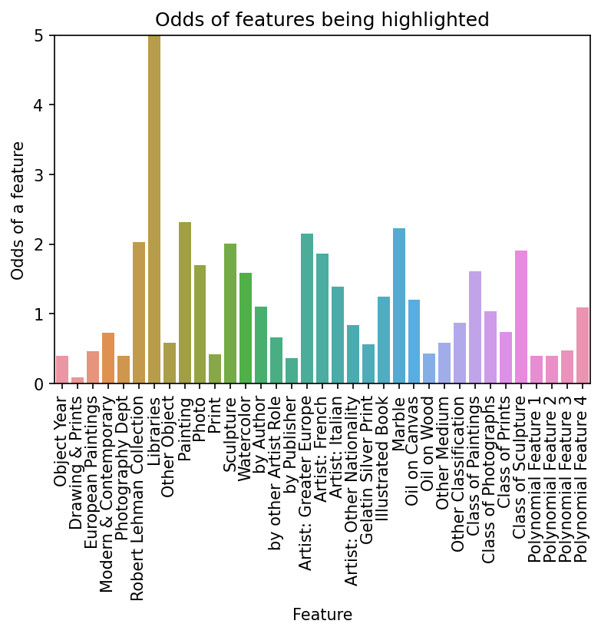
Odds - All

Slide 21
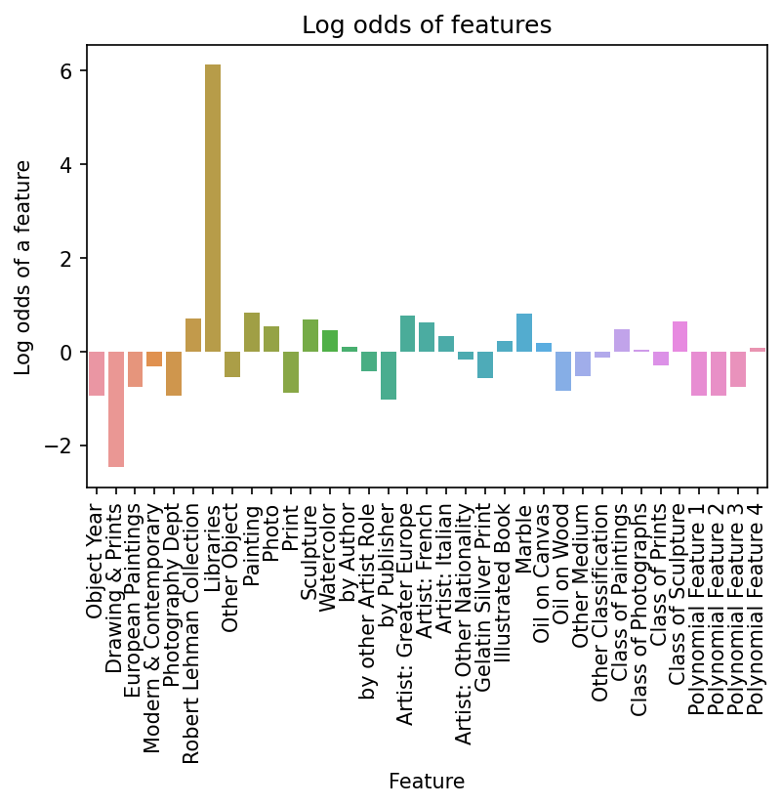
Log Odds - All

Slide 22
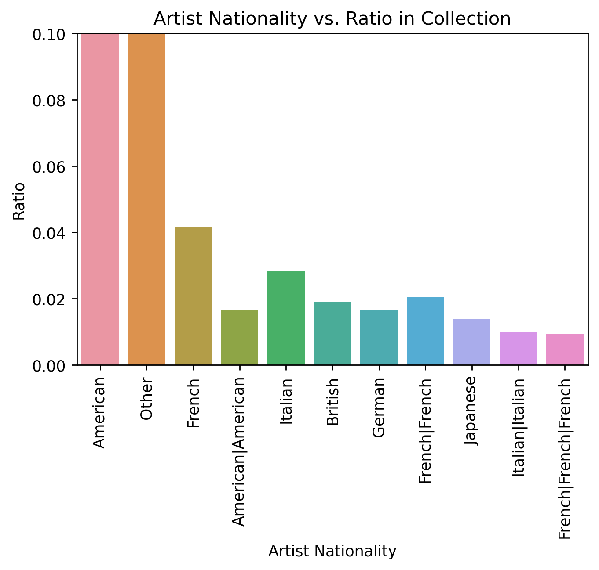
Collection Distributions

Slide 23
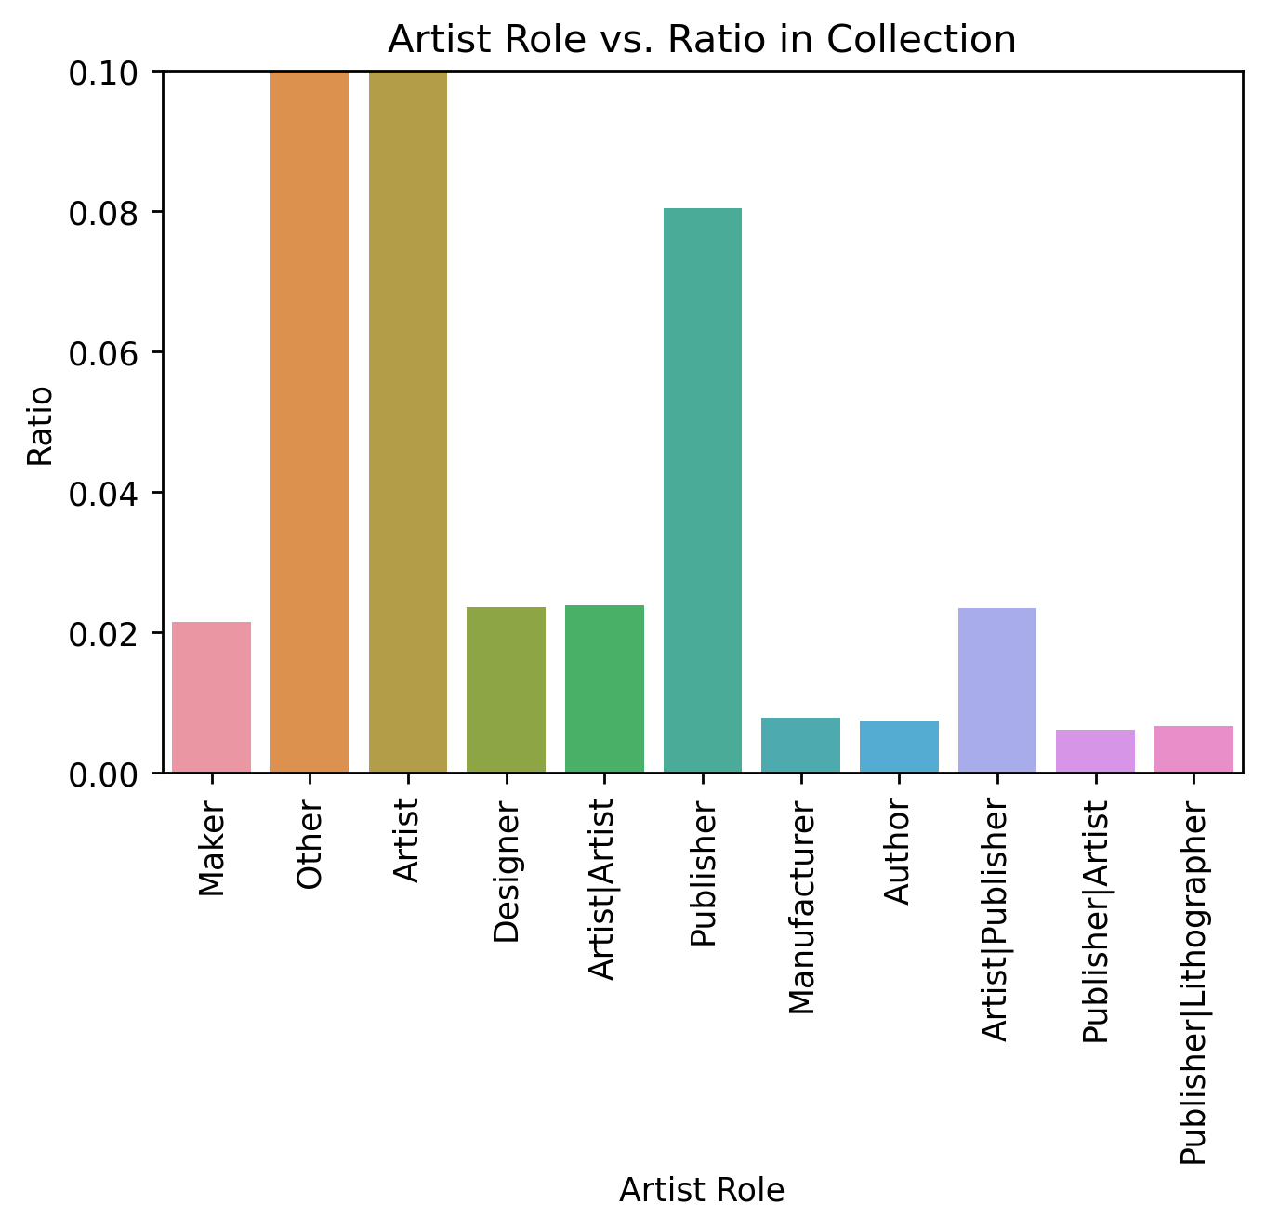
Collection Distributions

Slide 24
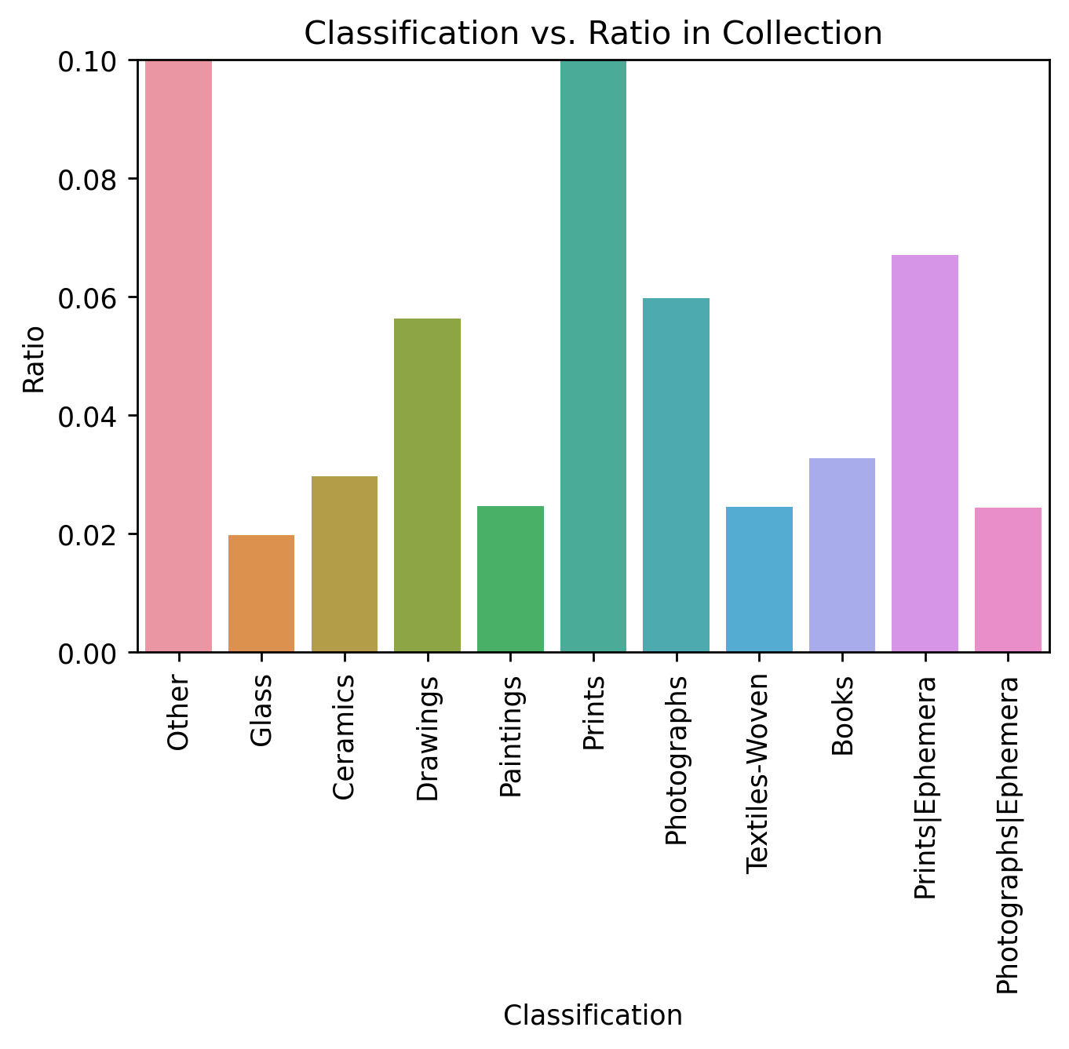
Collection Distributions

Slide 25
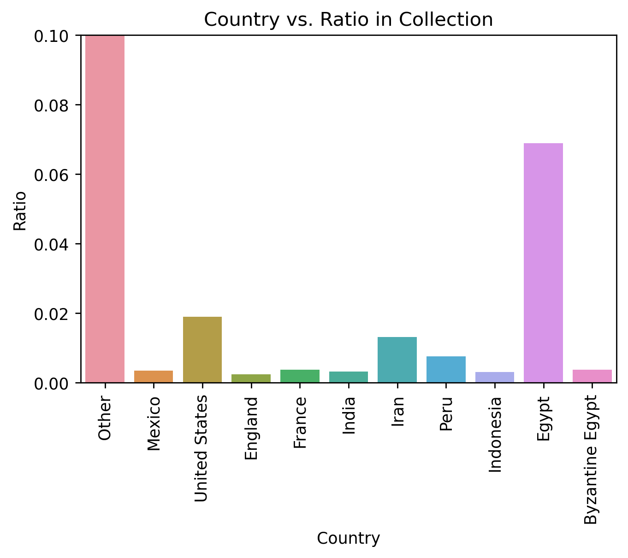
Collection Distributions

Slide 26
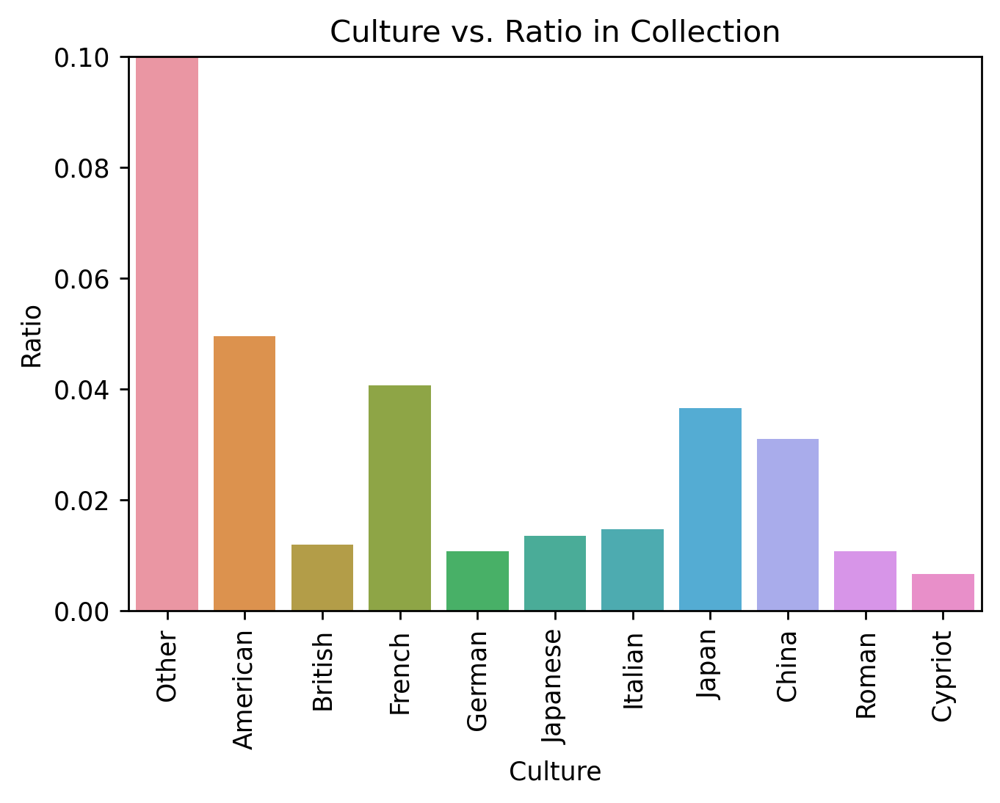
Collection Distributions

Slide 27
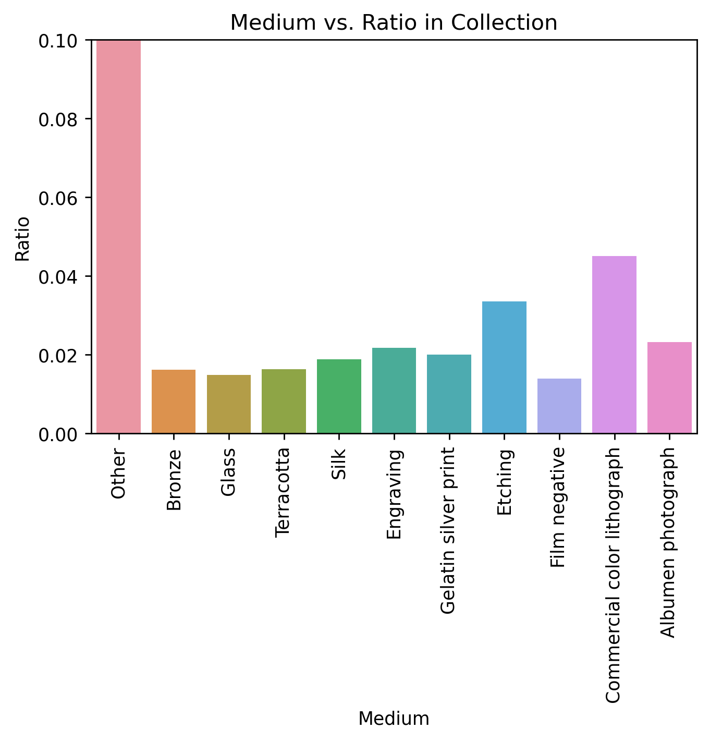
Collection Distributions

Slide 28
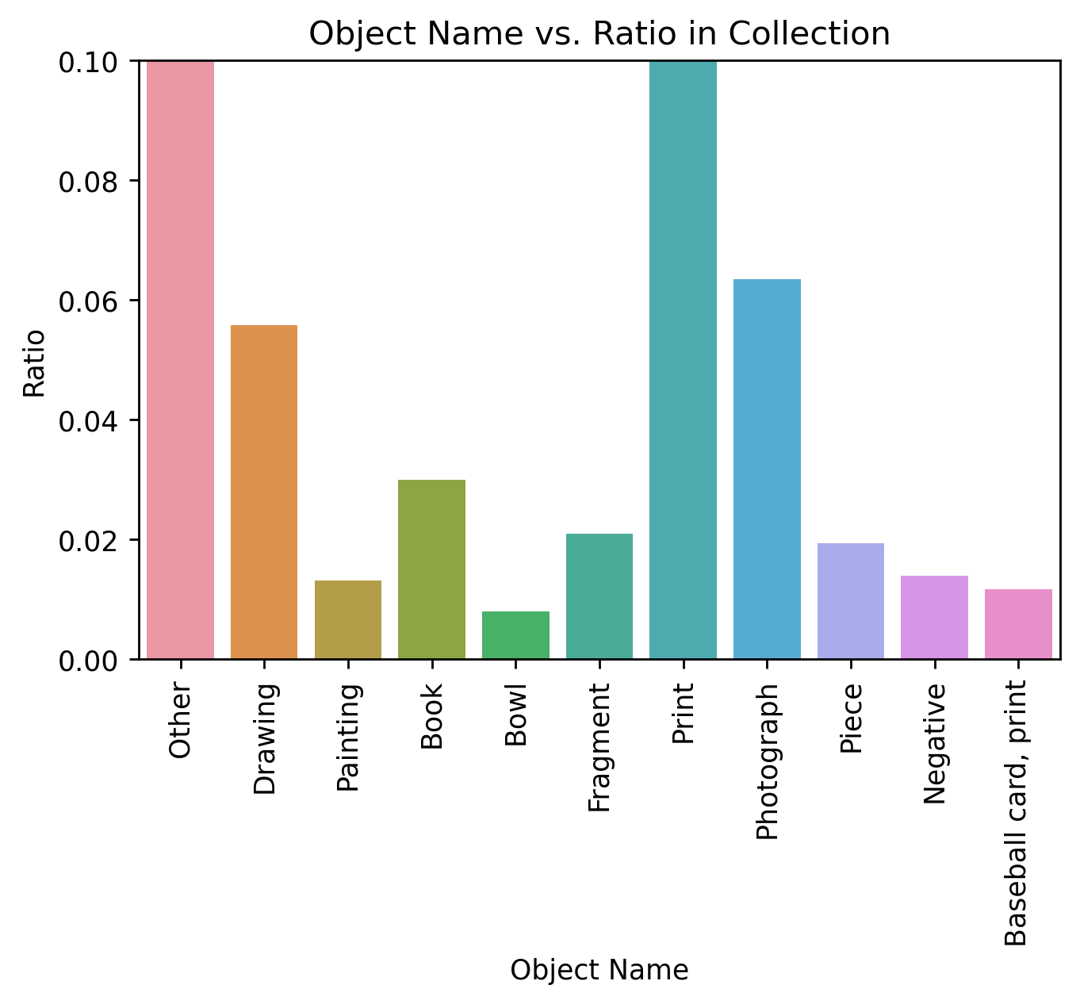
Collection Distributions

Slide 29
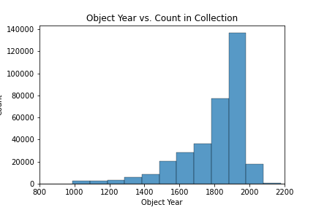
Collection Distributions

Slide 30
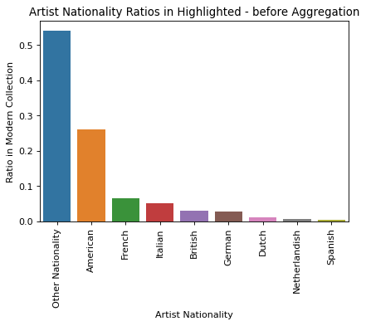
Modern
Highlights

Slide 31
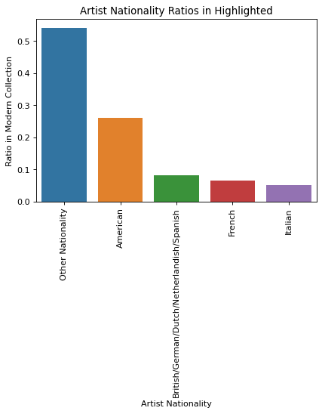
Modern
Highlights

Slide 32
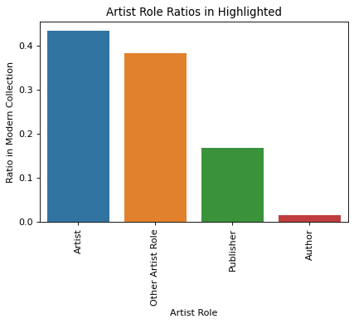
Modern
Highlights

Slide 33
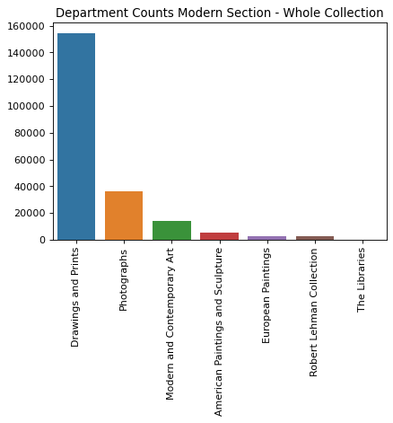
Modern
Highlights

Slide 34
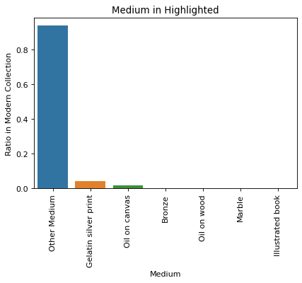
Modern
Highlights

Slide 35
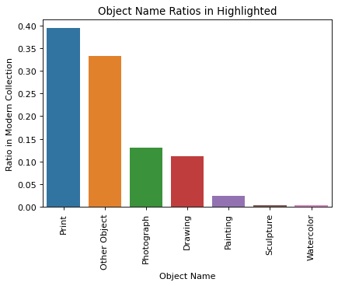
Modern
Highlights

Slide 36
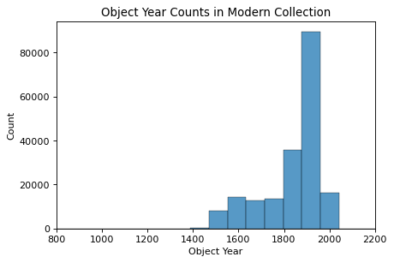
Modern
Highlights

Slide 37
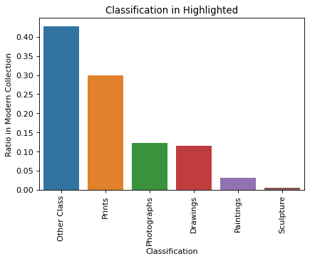
Modern
Highlights

